Slide 1

CSC1108 DSA Team Project Journey Planner
Group 7​
2200959 Peter Febrianto Afandy​ ​
2200692 Adrian Pang Zi Jian​ ​
2200936 Muhammad Nur Dinie Bin Aziz ​
2201159 Ryan Lai Wei Shao ​
2201018 Jeffrey Yap Wan Lin​

Slide 2
TABLE OF CONTENTS
01
04
02
05
03
Individual Contributions
Program Features
Introduction
Video Demo
Our Solutions
06
Review of Solutions

Slide 3
2200959 Peter Febrianto Afandy​ ​
Led and coordinated team efforts to successfully complete the project
Performed analysis and conducted research on given bus dataset and the various bus routes involved for the BAJ bus service.
Integrated the API provided by Malaysia's public transportation provider, Pengangkutan Awam Johor (PAJ), and the API provided by Google Maps into the project.
Created crawler program to get bus schedule data from the BusInterchange website, the dataset provided, PAJ's API and other sources. Program also performs calculation to obtain the estimated bus arrival time from the given bus schedules.
Created database design, MySQL database, deployed database into Google Cloud Platform SQL, and populated database with data obtained and processed.
Developed code for the following:
Connect to database and various complex SQL queries
Conversion of string addresses into their coordinates, and vice versa using Google Map's Geoencoding and Reverse Geoencoding API
Function to get the nearest bus stop for a given set of coordinates using the spherical haversine distance formula
Function to get the next fastest bus stop from a given bus stop, for the A Star algorithm
Function to integrate live bus data provided by the PAJ API into the A Star algorithm. Function determines which bus stop a given bus is headed towards through a series of calculations (ie determine direction where bus is headed, check if there is a route where the bus goes to a bus stop). These processing steps are required due to missing data from the API (ie target bus stop for a bus)
Function to obtain the walking instructions to a given destination point from a given starting point using the Google Map Directions API (mainly for walking towards the starting bus stop, and walking towards the end point from the end bus stop)
Sending email directions to the user through integration with Gmail
Input validation for user inputs in the web application
Assisted in testing of code and resolution of bugs, and addition of minor features to make the application more robust

Slide 4
2200692 Adrian Pang Zi Jian​ ​
Led and coordinated team efforts regarding use of Dijkstra's algorithm and HTML
Coordinated usage of Ajax call with flask
Coordinated usage of Flask route applications
Developed code for:
Shortest distance with minimum transfer using Dijkstra’s algorithm
Fully functional 'Journey Planner Telegram Bot' with returning of journey and functions to send email to user
UI Design for the front end, Ajax call definition for the back end
Flask route creation and redirection to front-end
Integration of live bus data into map, with active live updates upon each API call to the 'PAJ Live Bus Data API'
Definition of plotting of markers into Python folium map and returning to display in HTML
Researched and created definition for API calls to draw bus and walking routes on map based on actual terrain
JQuery and Javascript design for the inputs and form controls
Calling of libraries to graph the routes using Python Networkx and visualization of the routes using Matplotlib
Aided in Integration of resulting routes and bus numbers into HTML
Aided in bug testing and checking of inputs

Slide 5
2200936 Muhammad Nur Dinie Bin Aziz ​
Researched on algorithm designs for optimal wayfinding and concluded to shortest duration using A Star algorithm
Developed code for :
A Star Algorithm design
Heuristic function using haversine formula
Support functions for A Star and Dijkstra Algorithm such as:
Time conversion
BusStopID to coordinates conversion
BusID to bus name conversion
Structured code for bus stops and bus number tracking
Algorithm testing and bug fixing
Package cleanup to prevent circular imports and redundant files

Slide 6
2201159 Ryan Lai Wei Shao ​
User Interface Design – Developed using HTML, CSS and JavaScript
Responsive design
User Experience – Plan user flow of events
Extraction of:
Bus Data
Bus Stop Data
Bus Routes
Walking Routes
Filtering of data and address coordinates based on user's start and end destinations
Storing filtered data into a dictionary and output as JSON format for processing
Dynamically display routes and instructions onto the front-end HTML interface using AJAX

Slide 7
2201018 Jeffrey Yap Wan Lin​
Integrated the API provided by Google Maps and OSRM into the project
Extracted necessary data from SQL for data comparison
Integrated Dijkstra’s & A Star algorithm to plot designated bus route
Provided bus stop names and order of bus stop at each individual markers
Provided starting address to nearest bus stop & last mile connectivity route if necessary
Performed video recording and editing for the purpose of presenting the project demonstration.

Slide 8

Introduction

Slide 9


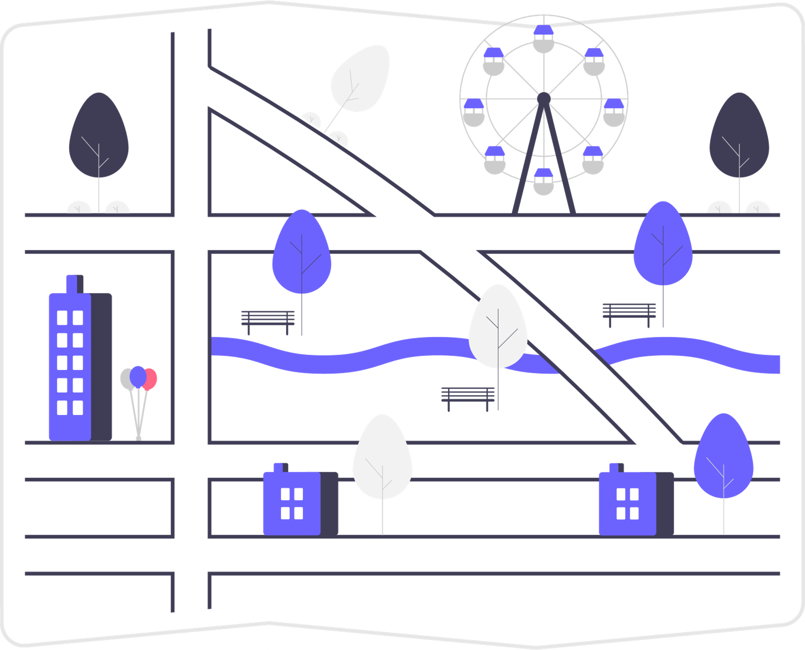
Terms
Bus Stop
Bus
Route
Location for commuters to get on & off a Bus
Examples: P101, P411-01
*Synonymous to Bus Service
Path between Bus Stops
⇔ One-Way Buses | ⊃ Loop Buses
Notes:
Definition of some terms before moving on

Slide 10

Assumptions
Assume buses will arrive on time, as specified by the bus schedule
Assume all bus service information (ie coordinates) provided in the given dataset are correct (minor corrections were made).
Assume all buses will adhere to the specified bus schedule every day of the week, not accounting for any other factors (ie bus breakdowns).
Assume all buses will travel at the constant speed of 70km/h.
Assume users will take a bus to travel to their destination, regardless of the distance between their starting point and ending point (ie regardless if it is faster if the user walks to their endpoint)

Slide 11
Project Scope: Loop Services
Route planning limited to buses and bus stops provided in given dataset:
P101 – Larkin Terminal ⊃ Johor Bahru City
Start: Larkin Terminal
End: Larkin Terminal
P106 – PPR Sri Stulang ⊃ AEON Tebrau City
Start: Hub PPR Sri Stulang
End: Hub PPR Sri Stulang
P202 – Taman Universiti ⊃ Taman Ungku Tun Aminah
Start: Taman Universiti Terminal
End: Taman Universiti Terminal
P403 – Econsave Senai ⊃ Skudai Parade
Start: Econsave Senai
End: Econsave Senai

Slide 12
Project Scope: One-Way Services
Route planning limited to buses and bus stops provided in given dataset:
P102 – PPR Sri Stulang ⇔ Majlis Bandaraya Johor Bahru
P102-01
Start: Hub PPR Sri Stulang
End: Majlis Bandaraya Johor Bahru
P102-02
Start: Majlis Bandaraya Johor Bahru
End: Hub PPR Sri Stulang
P211 – Taman Universiti ⇔ Larkin Terminal
P211-01
Start: Taman Universiti Terminal
End: Larkin Terminal
P211-02
Start: Larkin Terminal
End: Taman Universiti Terminal
P411 – Kulai ⇔ Larkin Terminal
P411-01
Start: Kulai Terminal
End: Larkin Terminal
P411-02
Start: Larkin Terminal
End: Kulai Terminal

Slide 13
Project Scope: Excluded Bus Stops
The following bus stops were excluded (instructed to ignore bus stops in the dataset):
KFC (Road-side)
P202
Tesco Lotus (Road-side)
P202
bef Jalan Kempas Lama
P211-01
P411-01

Slide 14

Our Solutions

Slide 15










System Design
Send API call
Process Requests
Fetch / Store Data
Send API call
Send Email
Journey Planner
Application
Send API call
Enter start, end locations & desired route type
Output shortest / fastest path
Receive Email
User

Slide 16
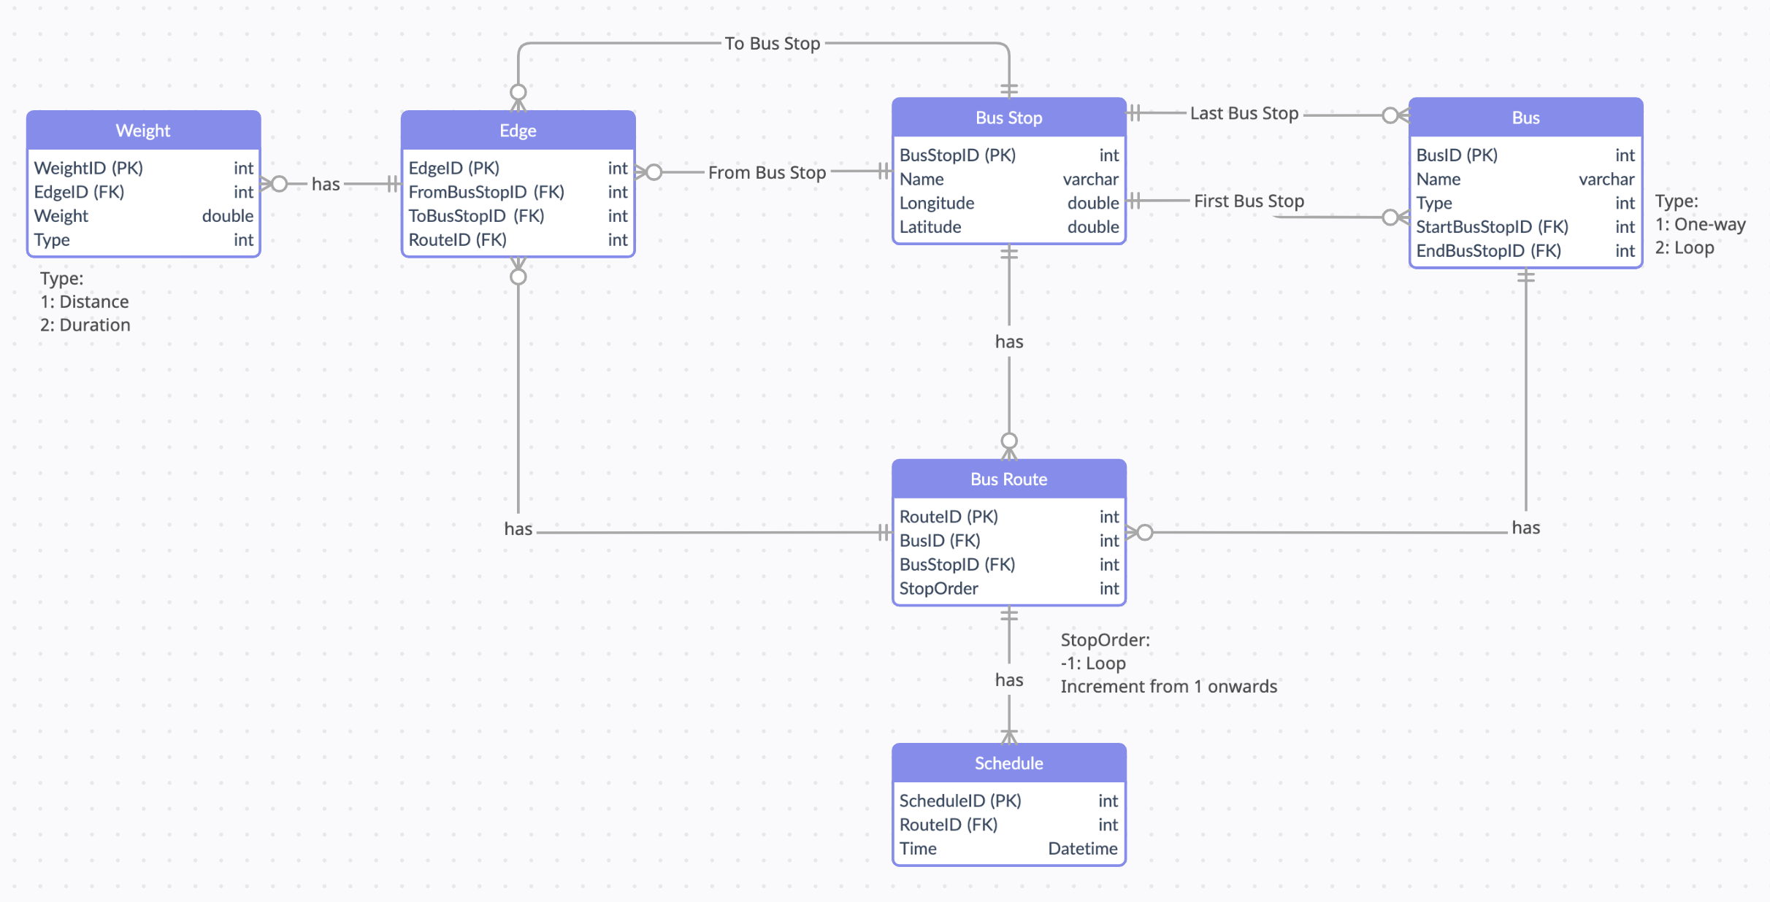
Database Design

Slide 17

User Flow
1. User enter inputs
Starting Address
Destination Address
Route option (Shortest or Fastest Path)
2. Validate user’s inputs
Convert address to coordinates or vice versa
Locate nearest bus stop from start address and end address
3. Guide user to bus stop, if not already there (walking directions)
Guide user to nearest bus stop
4. Determine bus route
Run selected path algorithm (Shortest or Fastest Path)
Determine bus route from nearest bus stop
Display the bus route and number to take at each bus stop
5. Guide user to endpoint, if not already there (walking directions)
Guide user to destination

Slide 18

Program Features

Slide 19
Default Python Library Used
Graphing
Python "Networkx" module to generate a Directional Graph
"Matplotlib" module to plot the graph into a JPG
Data Structure
"Heapq" priority queue to maintain smallest element to dequeue
Used in Dijkstra Algo
Used in A-Star Algo

Slide 20
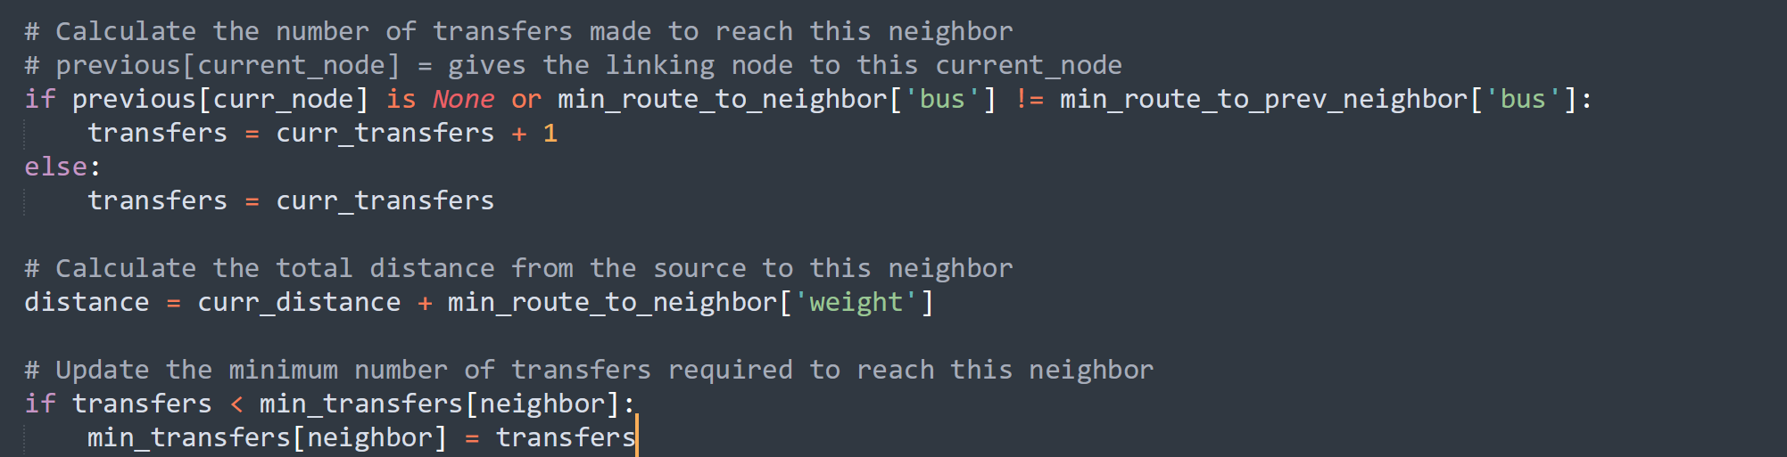
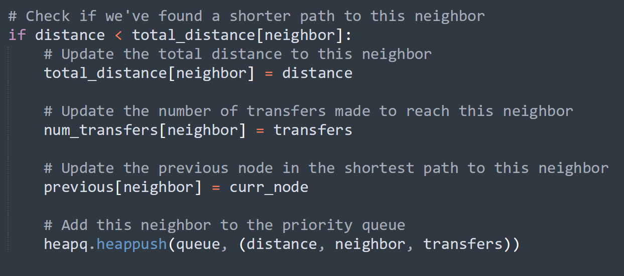
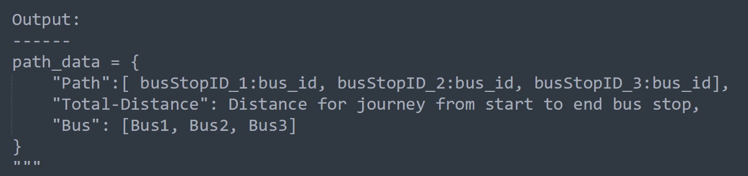
Data Structures
Dijkstra Algo (Greedy Algorithm for shortest path)

Slide 21
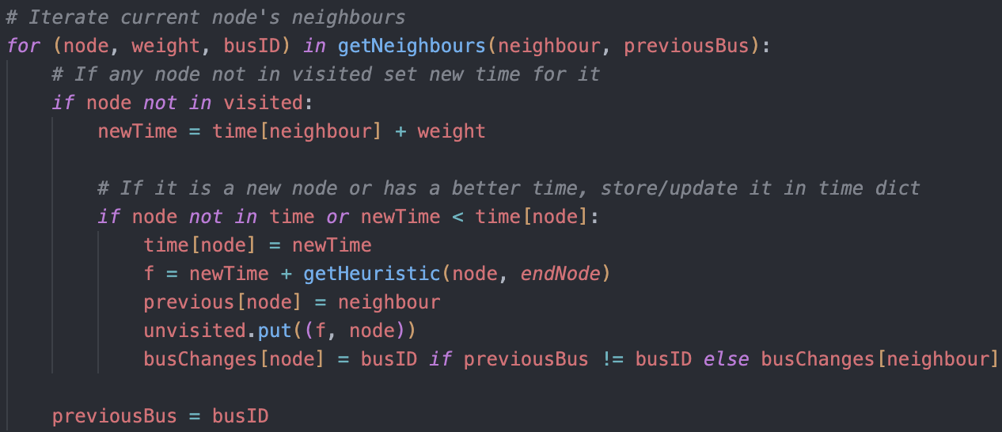
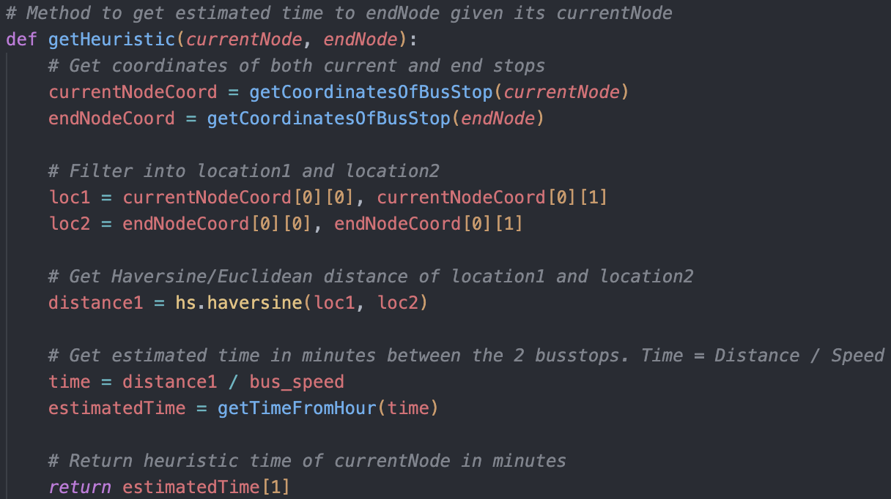
Data Structures
Loops through every node
starting with lowest time first
Heuristic function to calculate
Estimated time to reach end node

Slide 22
Data Structures – A Star
A Star Algorithm uses:
MySQL to retrieve the connections between bus stops
Vertex: BusStopID
Edge: EdgeID
Weight of each edge:
Duration of travel between bus stops
Duration of waiting time for next bus
Priority Queue store and get shortest total time
Bus Stops are connected to each other via Buses
Total time as weight

Slide 23


Use of Algorithms
Dijkstra Shortest Path with minimum bus transfer
Dijkstra’s seeks the shortest path between start node and next node
A Star algorithm with heuristic function
A Star seeks the shortest time between start node and end node
Performs like Dijkstra but with heuristic function calculating estimated weight to end node
Calculated using Haversine distance and must be admissible (NEVER overestimated)
Alternate algorithm selection by distance or time

Slide 24
User Interface
Main user interface for this application is deployed using the Flask Python web framework
The Flask application is responsible for:
Constructing user interface HTML pages using templates
Integrates with third-party libraries like WTForms
Input handling
Form validation
Displaying the findings to the user
Allow ease of incorporate data processing tasks for the web applications
Integration with Python scripts
Process data
Utilise SQLAlchemy to interact with MySQL database

Slide 25
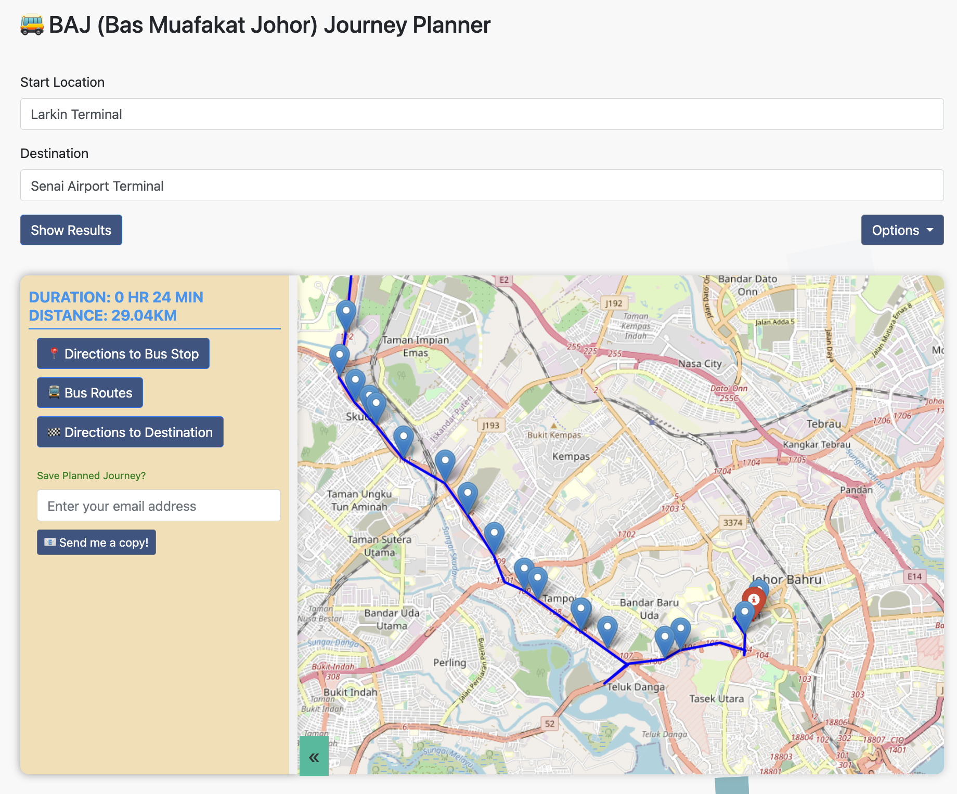
User Interface
Plots the map route based on user's start and end location
Starting and destination markers in (red)
Identifies walking route (red) to nearest bus stop at start and end locations
Displays bus route (blue)
Bus stop name
Bus stop order
Bus stop markers (blue)
Bus number
Total duration of trip
Bus changes (blue)

Slide 26
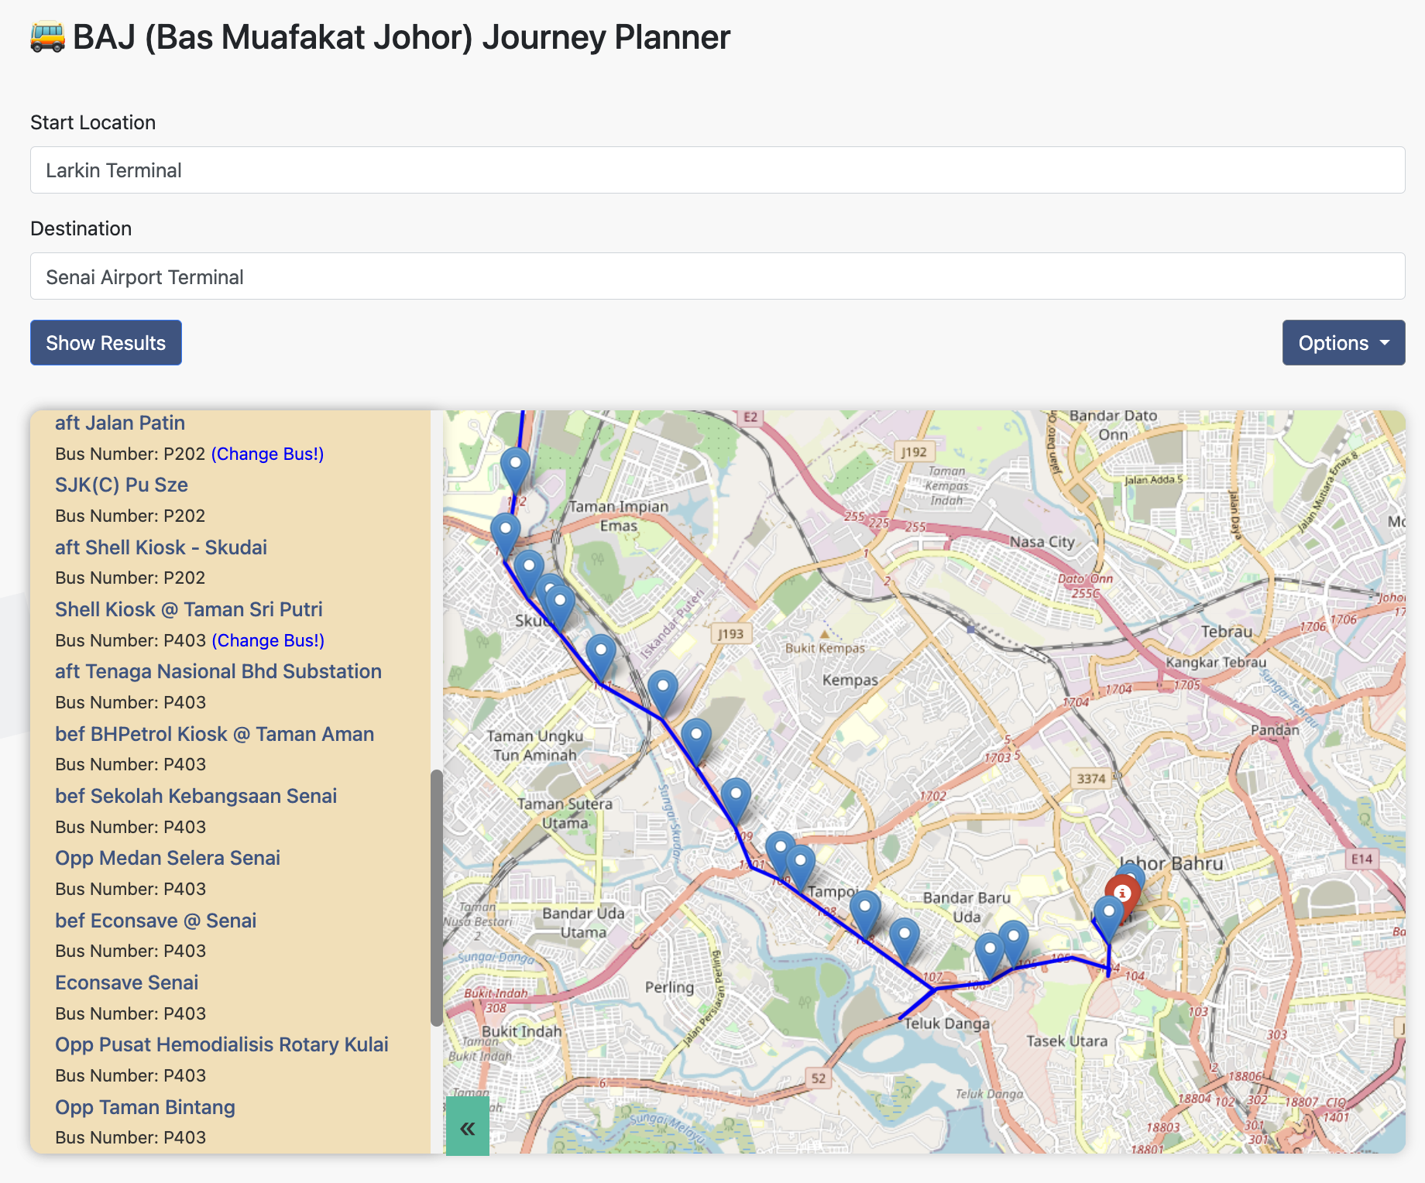
User Interface: Changing of Bus

Slide 27
Plot route with Google Maps API and OSRM
Walking path
Generated using Google Maps API
Includes origin, destination coordinates and mode of transportation (walking)
Route between Stops
Generated using our algorithms and uses Google Maps API if less than 25 waypoints (Google map API limit is 25)
Generated using our algorithms and uses OSRM API if more than 25 waypoints
Includes origin, destination coordinates, mode of transportation (driving), and API key or OSRM URL with coordinates of all stop
Polyline Decoding
Polyline returned by API is decoded using polyline library
Decoded into a list of latitude and longitude coordinates
Adding Polylines and Markers
Decoded polyline is added to map as polyline object with specified color
Markers added to map for each stop in stops list, using stop coordinates and popup with stop number

Slide 28

Advanced Features

Slide 29
Advanced Features: Overview
MySQL Database hosted on Google Cloud Platform (SQL)
Integration of live bus data from PAJ’s API into fastest path algorithm (A Star) and user interface
Integration with Google Map API
Web Crawler for getting bus schedule information from the BusInterchange.net website, with portability for all other bus services provided by BAJ
Email directions to user
Telegram bot for getting directions
Input validation to support coordinate and text address inputs, whilst preventing erroneous inputs

Slide 30
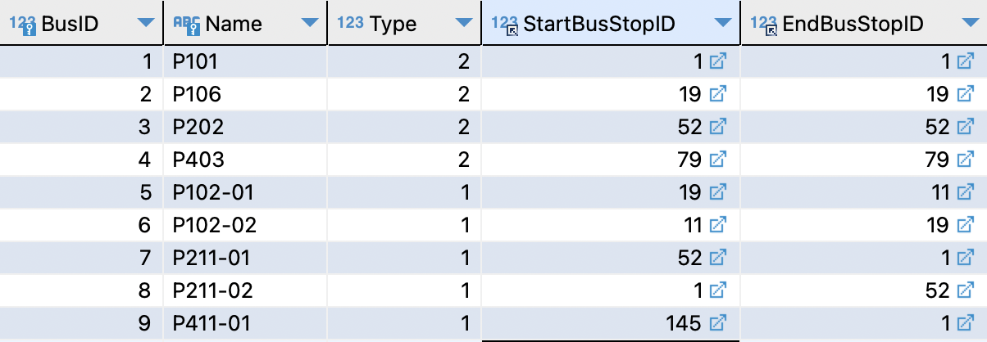
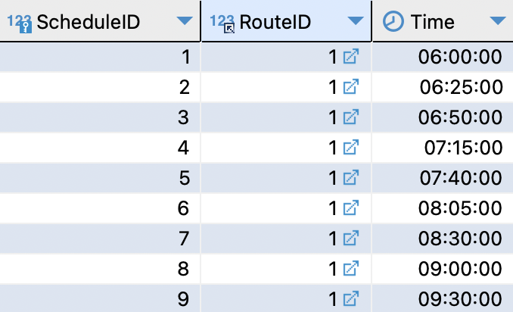
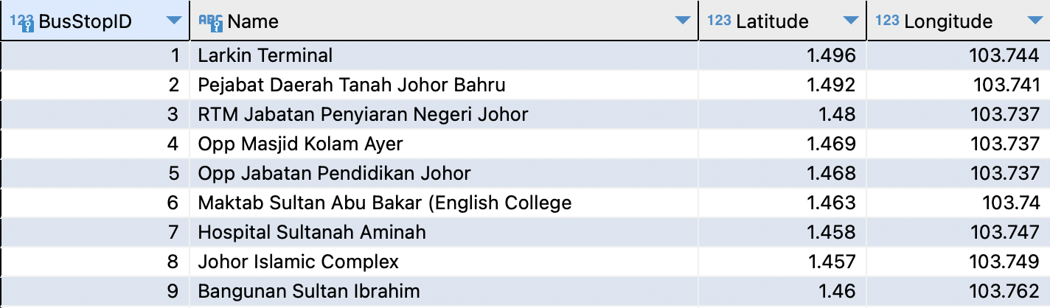
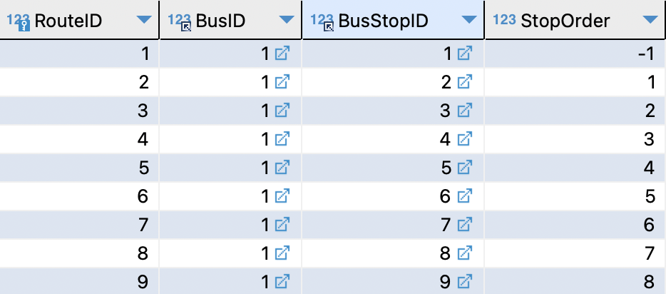
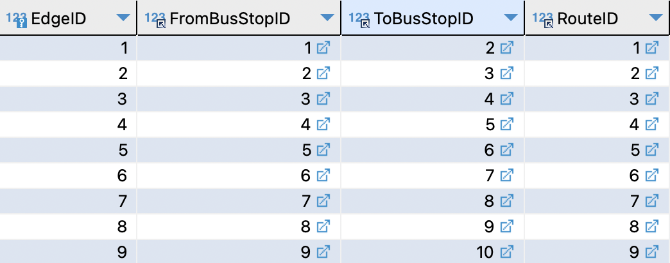
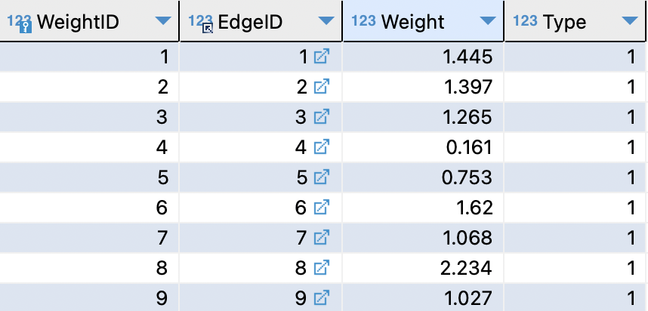
Advanced Features: MySQL Database
Buses
Bus Schedule
*Mapping between Bus & Bus Stop
Bus Stops
Bus Routes
Edges
*Connection between Bus Stops
Edge Weights

Slide 31
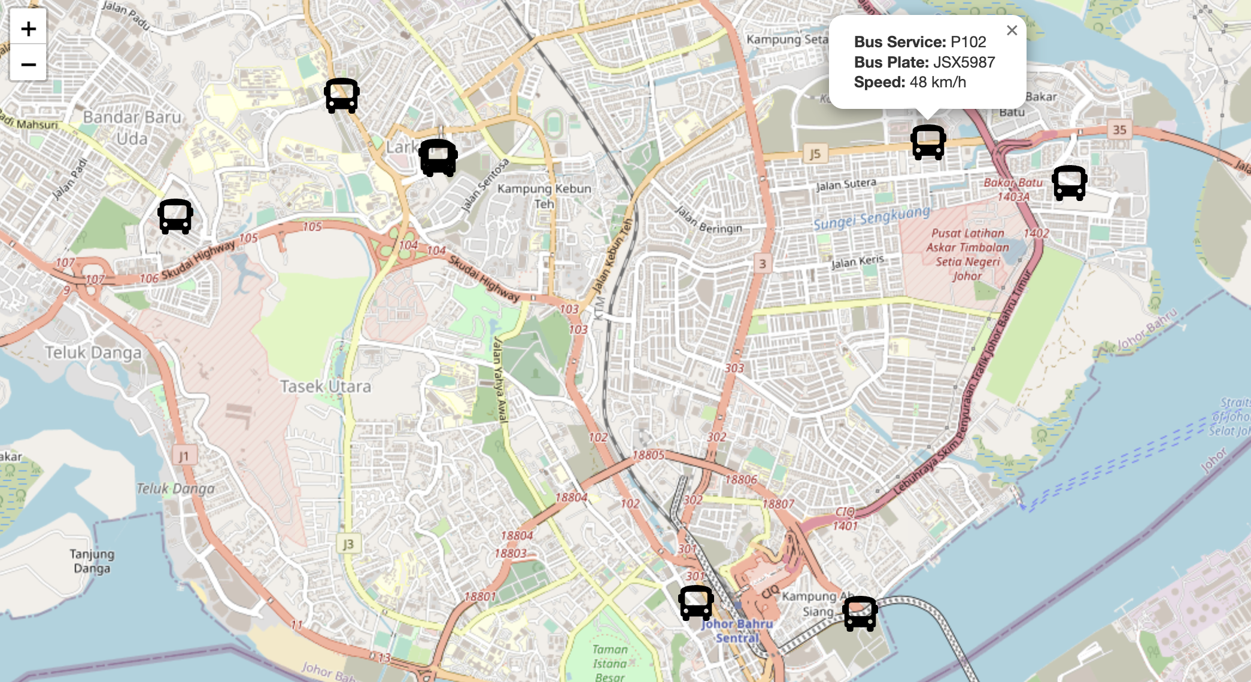
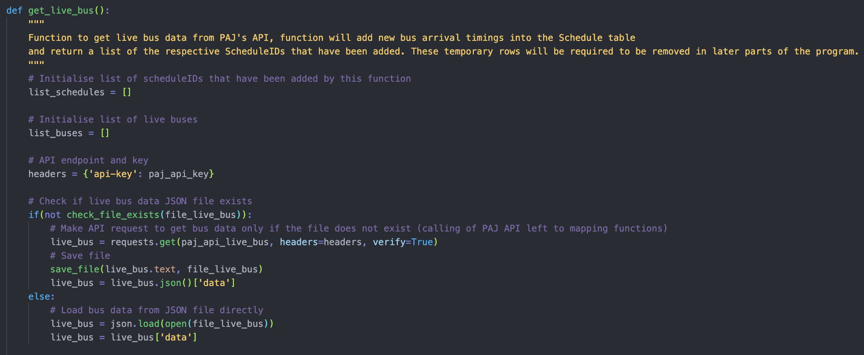
Advanced Features: Live Bus Data
Live Bus Data reflected on Map
Integration of Live Bus Data with A Star Algorithm
(Slow)

Slide 32
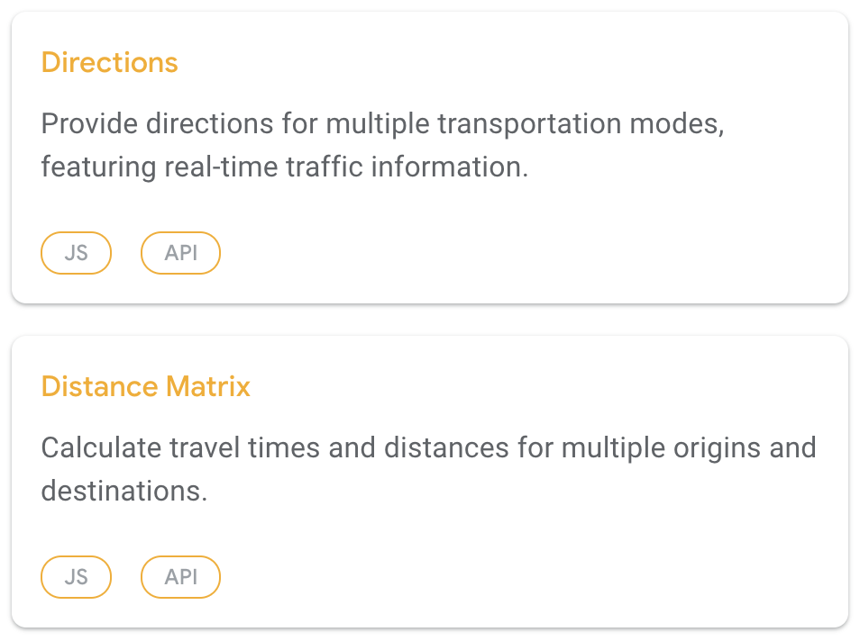
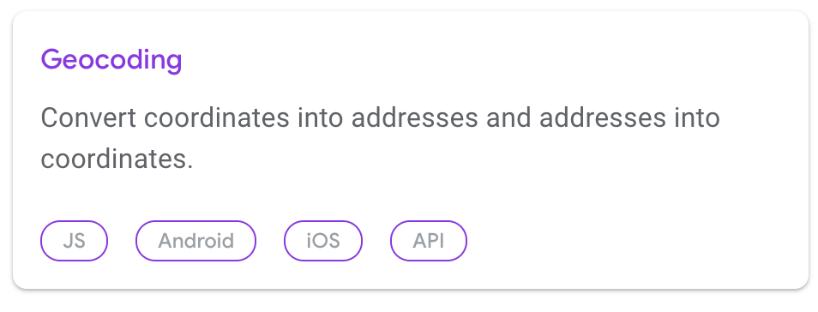
Advanced Features: Google Maps
Getting distance between Bus Stops
Coordinate ⇔ Address Conversions
Walking Directions to Bus Stop

Slide 33


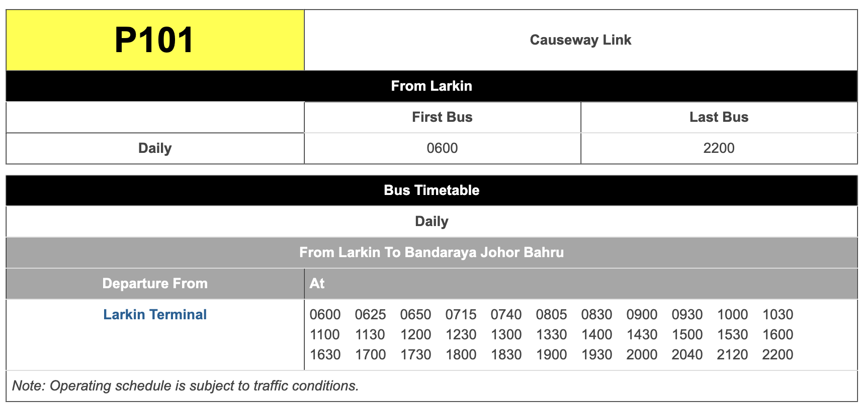

Advanced Features: Web Crawler
Obtain bus schedule data from website programmatically
Designed for portability
(easy expansion of bus routes)

Slide 34
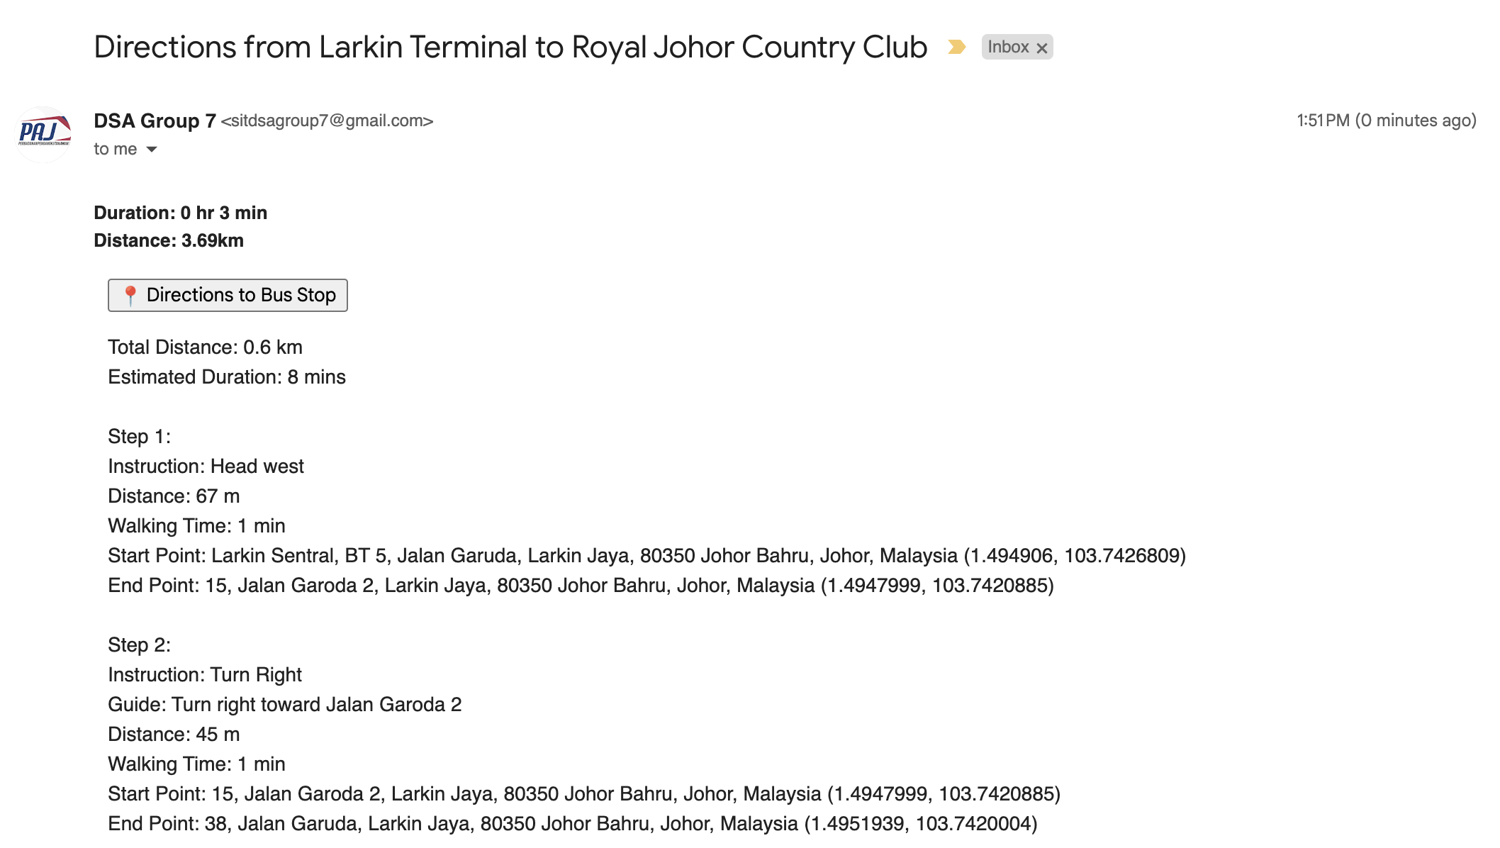
Advanced Features: Email
Email a copy of directions to user

Slide 35
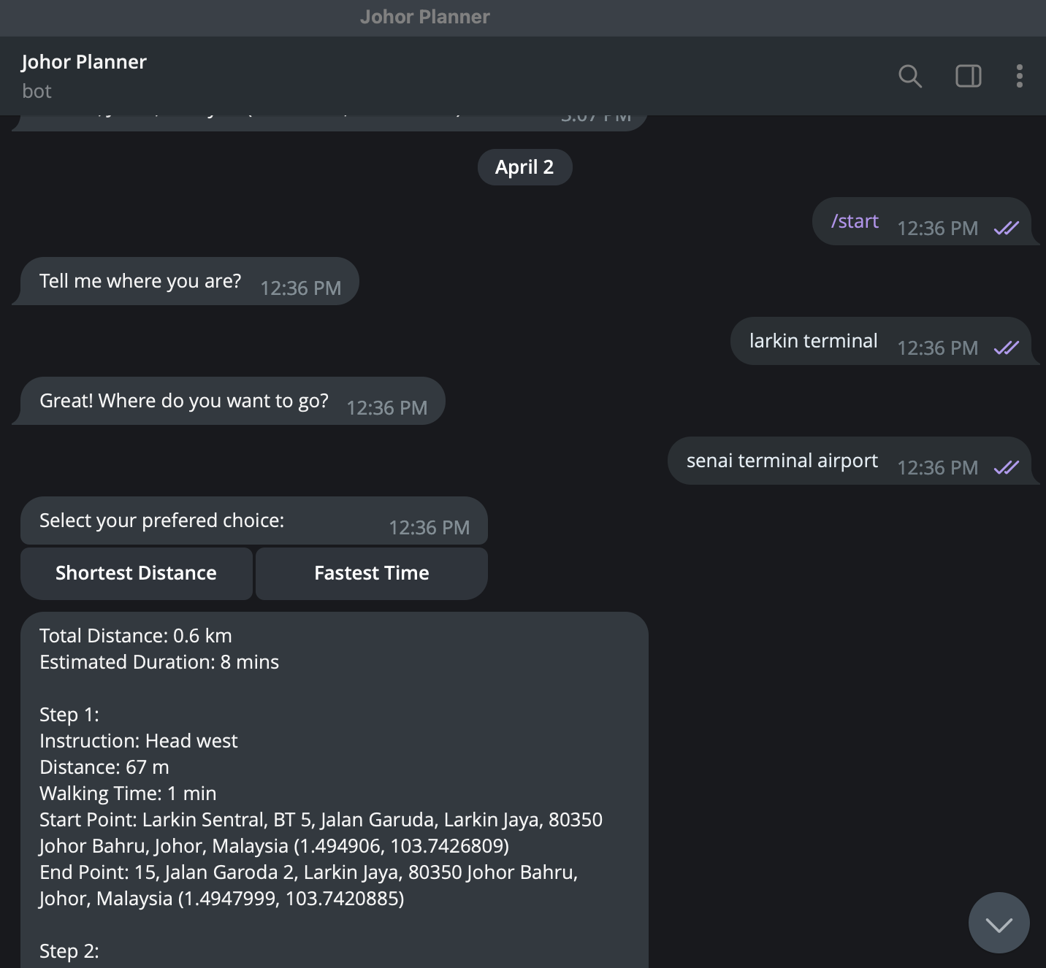
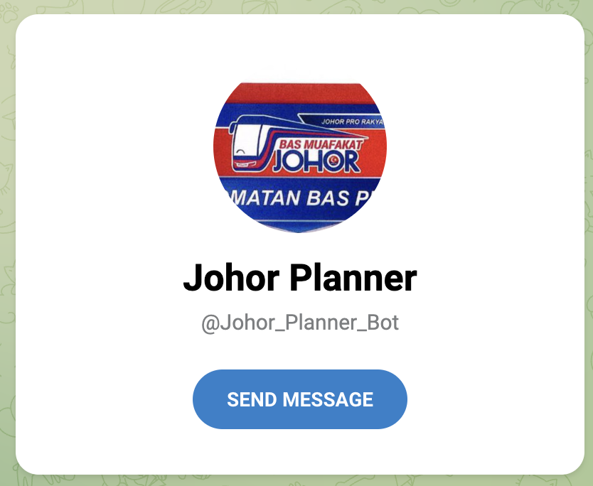
Advanced Features: Telegram Bot
TeleBot provides chat-based interface for bus journey planning
@Johor_Planner_Bot

Slide 36
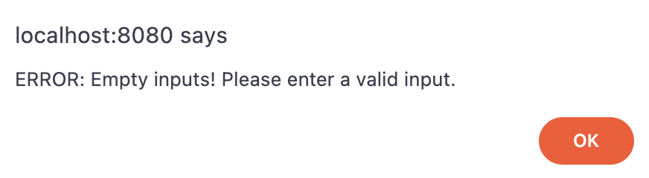
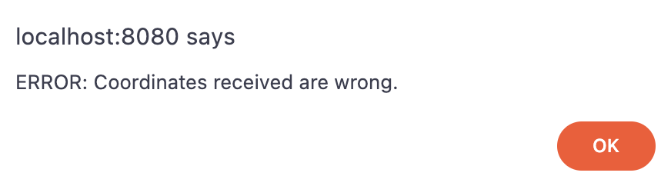
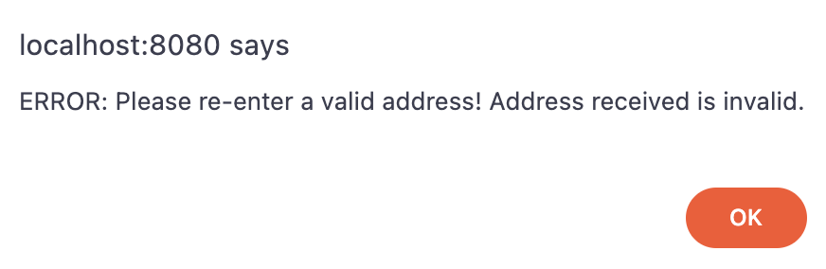
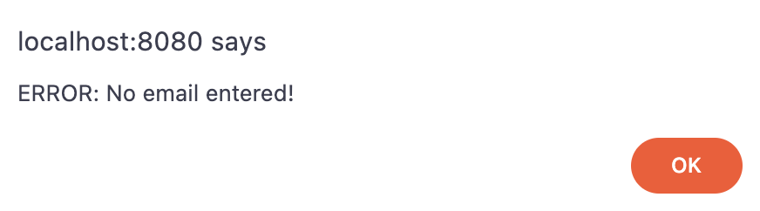
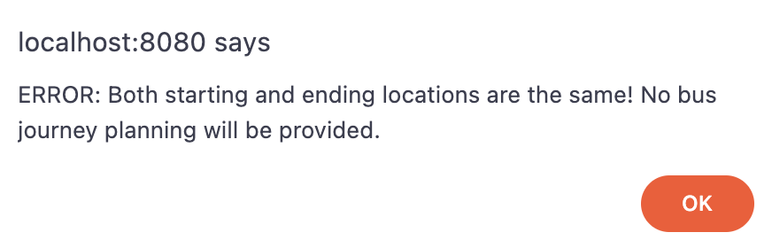
Advanced Features: User Validations
Check for valid addresses
Check for valid coordinates
Check for valid email

Slide 37
Future Work
Host Flask application on a web server
Integration of other bus services and bus stops
Filtering of paths, for example by number of bus changes, preferred bus service
Make buses move from one point to another (dependent on API)
Develop an interactive map that allows users to select two locations by simply clicking on the map and generate a route between them
Insert icons representing bus stops to the map and enable the display of available buses at individual bus stop
Enable 3D rotation of the map to provide a view of all directions.

Slide 38
Limitations
Can only generate one route at a time (require refresh of page if want to use new route / algorithm)
A Star Algorithm is slow, even slower when live bus data is used
Current integration of live buses (provided by PAJ API) with A Star algorithm is slow
Function to get live bus data has time complexity of O(n²)
API does not provide enough information about where a bus is headed
Need to programmatically determine:
Direction of bus based on its bearing
Bus stops a bus is potentially headed to, based on bearing & distance between bus and every other bus stop
Determine whether there is a valid route between bus and bus stops
Workaround: Program flag added to toggle use of live bus data during algorithm
PAJ API rate limited to 6 requests per minute (need to space out request timings)
Slow load time
Timings generated using Dijkstra algorithm is not accurate as details such as bus timings are not factored in
Algorithms did not factor in the bus routes of close-by bus stops (ie cross the road to another bus stop to take a bus)

Slide 39

Thank you!

